Slide 1
RECAP

Slide 2
Intelligent agents are software programs that perform specific tasks on behalf of their users. They can be designed to analyze data, automate tasks, and provide recommendations based on predefined rules and algorithms. Intelligent agents can help organizations to automate routine tasks, reduce errors, and increase efficiency.

Slide 3
Expert systems are computer programs that mimic the decision-making abilities of a human expert in a particular field. They are designed to apply domain-specific knowledge to solve complex problems and provide recommendations to users. Expert systems can help organizations to capture and retain the knowledge of their experts, even after those experts retire or leave the organization.

Slide 4
Case-based reasoning agents are software programs that learn from past experiences to solve new problems. They work by storing previous cases, along with the solutions that were used to solve them. When faced with a new problem, the case-based reasoning agent searches its database of previous cases to find a similar problem and the solution that was used to solve it. The agent then adapts the previous solution to the new problem. Case-based reasoning agents can help organizations to leverage their past experiences and learn from previous mistakes.

Slide 5
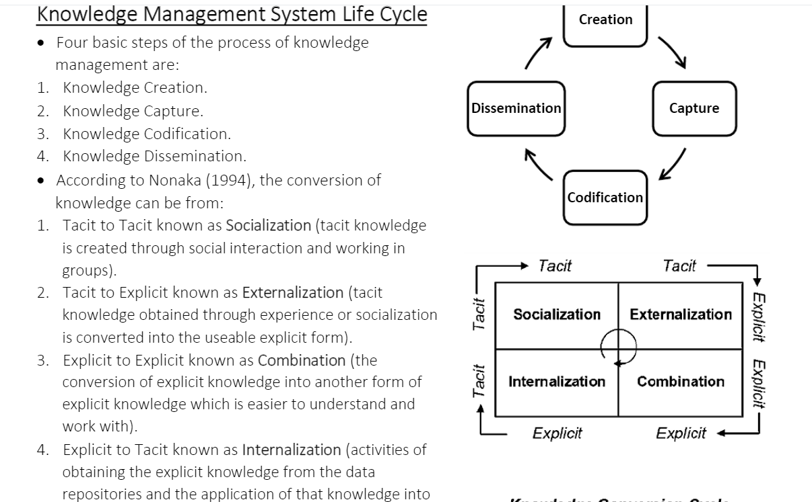

Slide 6
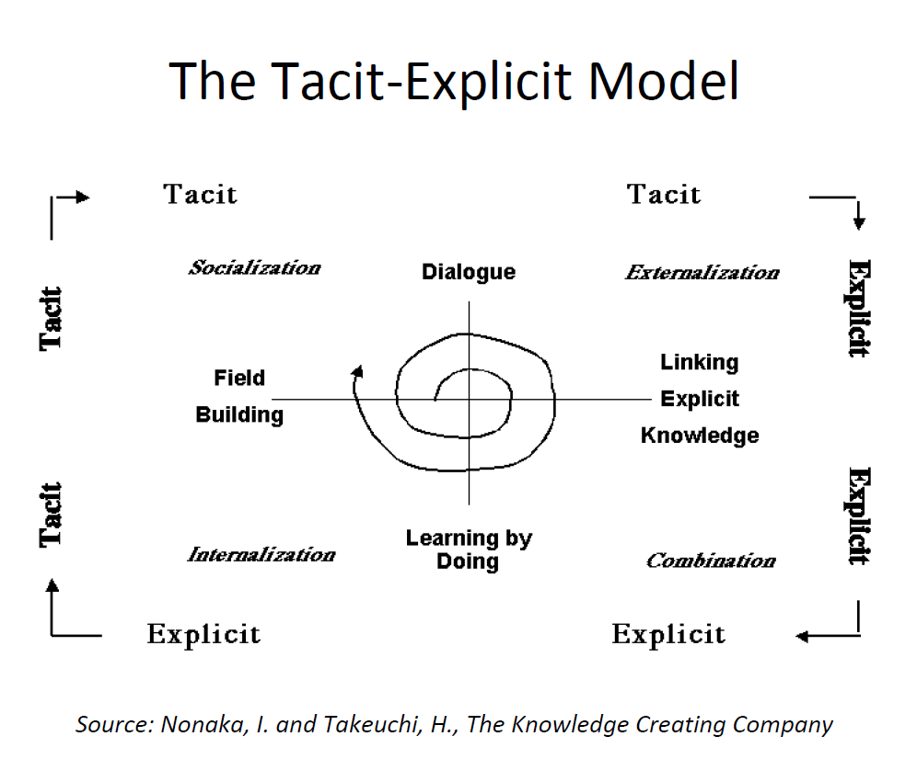

Slide 7
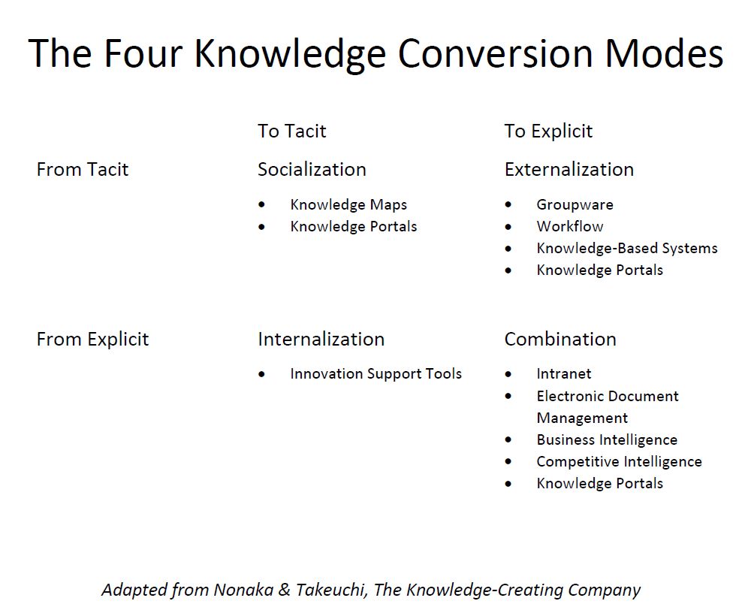

Slide 8
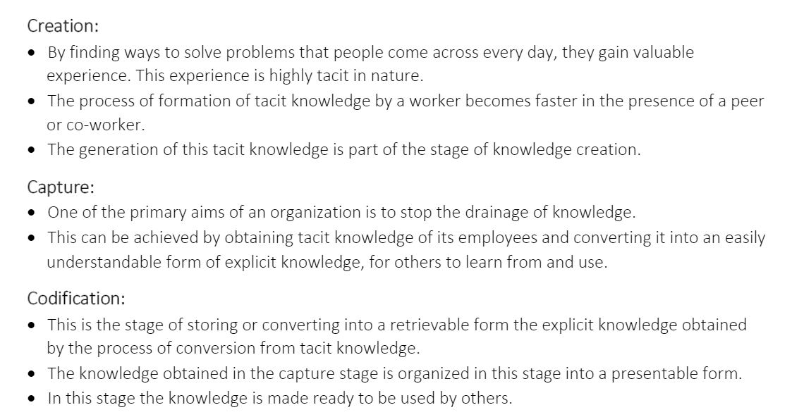

Slide 9
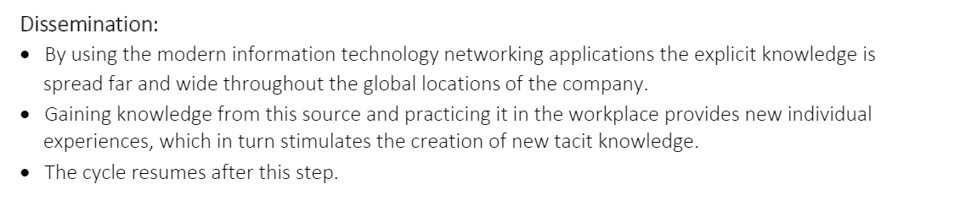

Slide 10
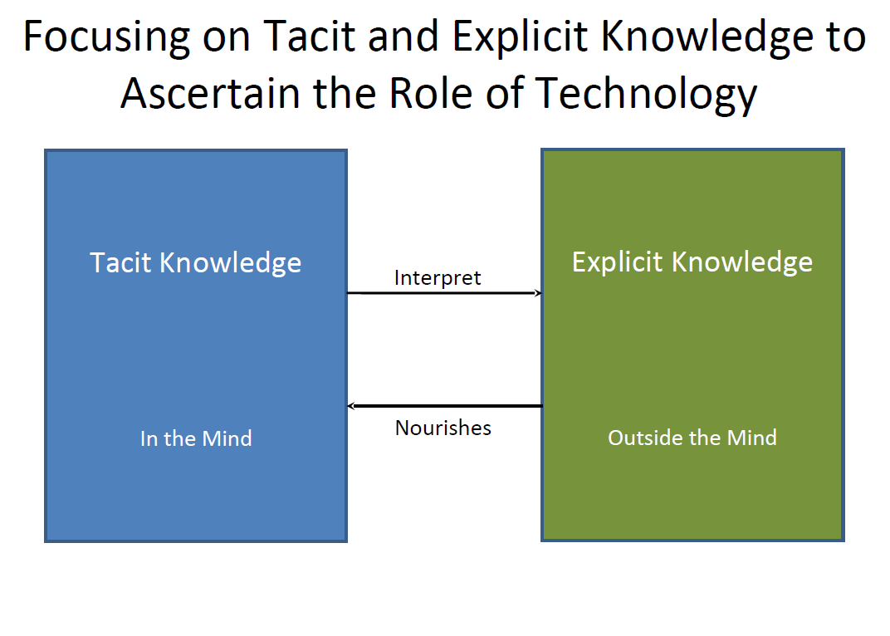

Slide 11
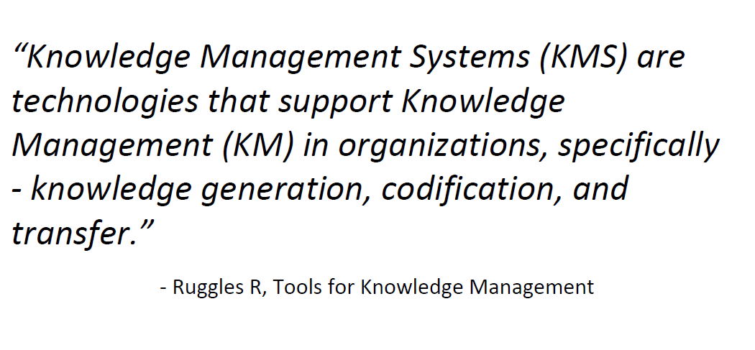

Slide 12
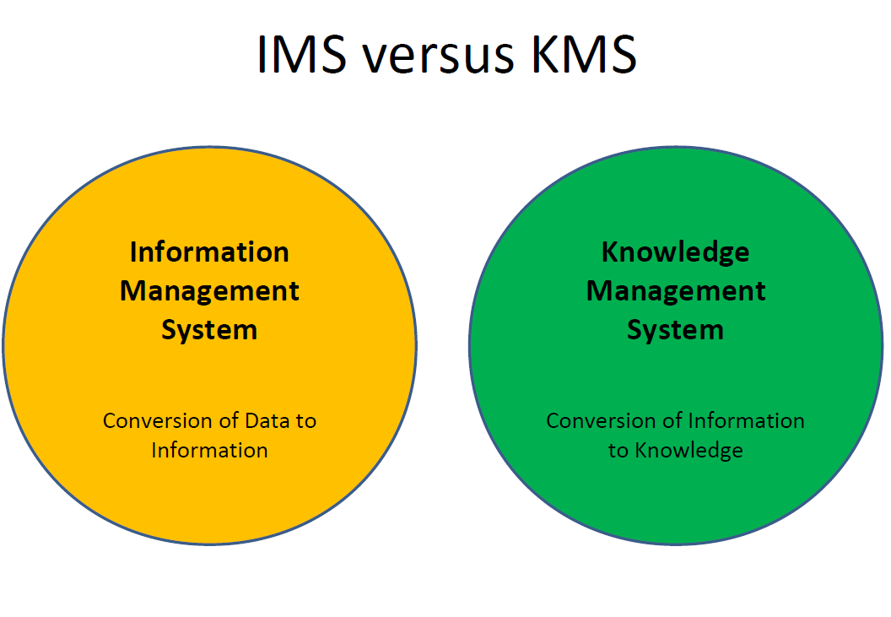

Slide 13
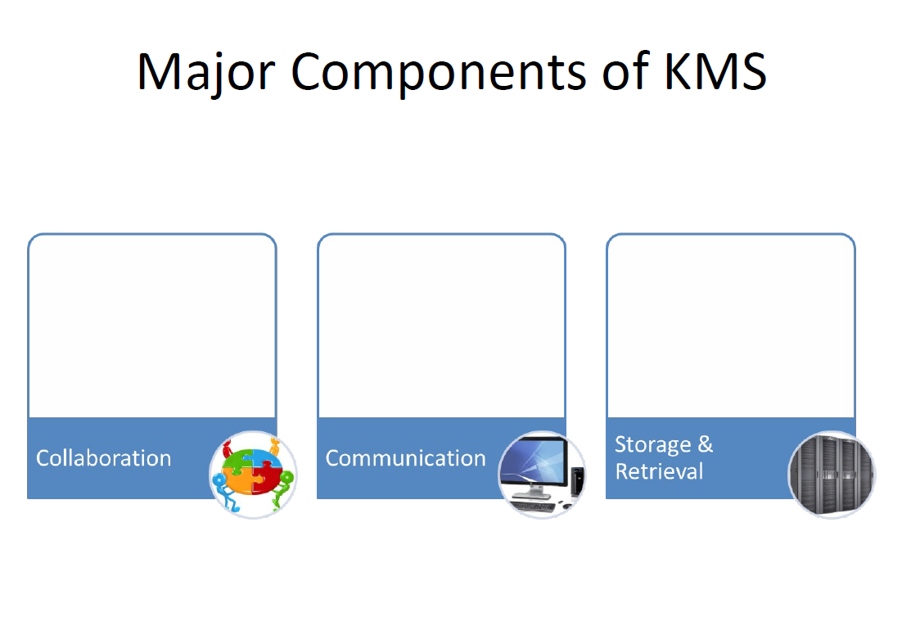

Slide 14
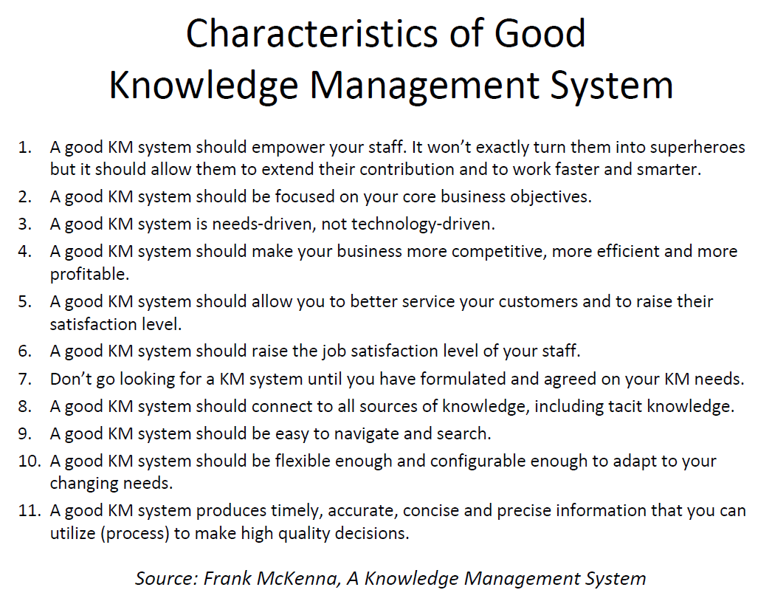

Slide 15
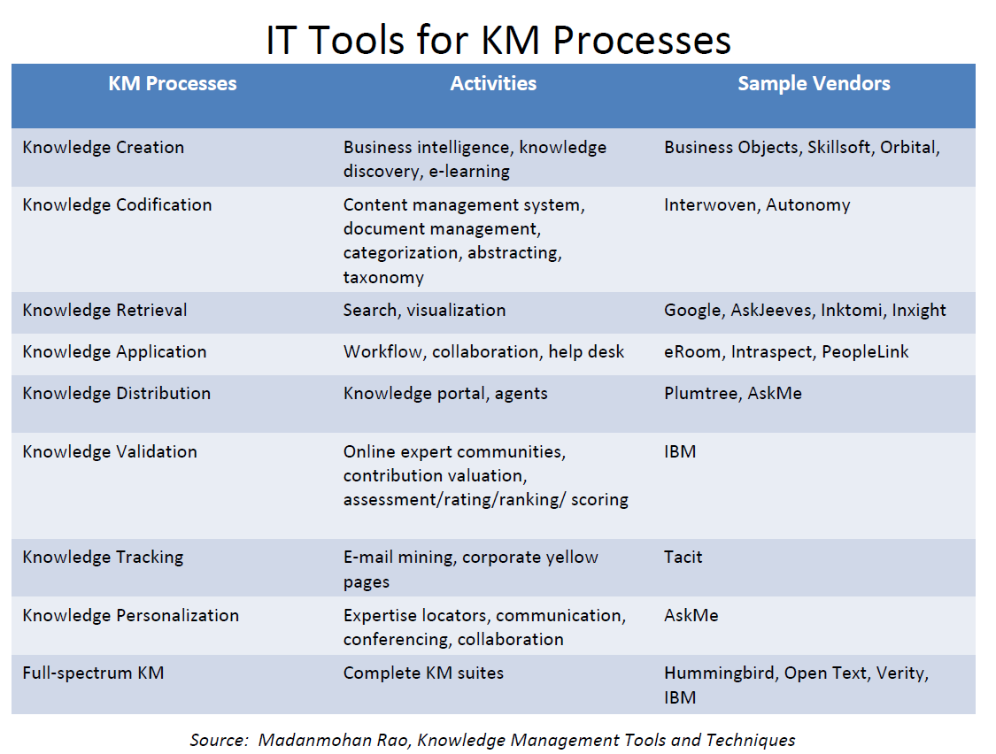

Slide 16
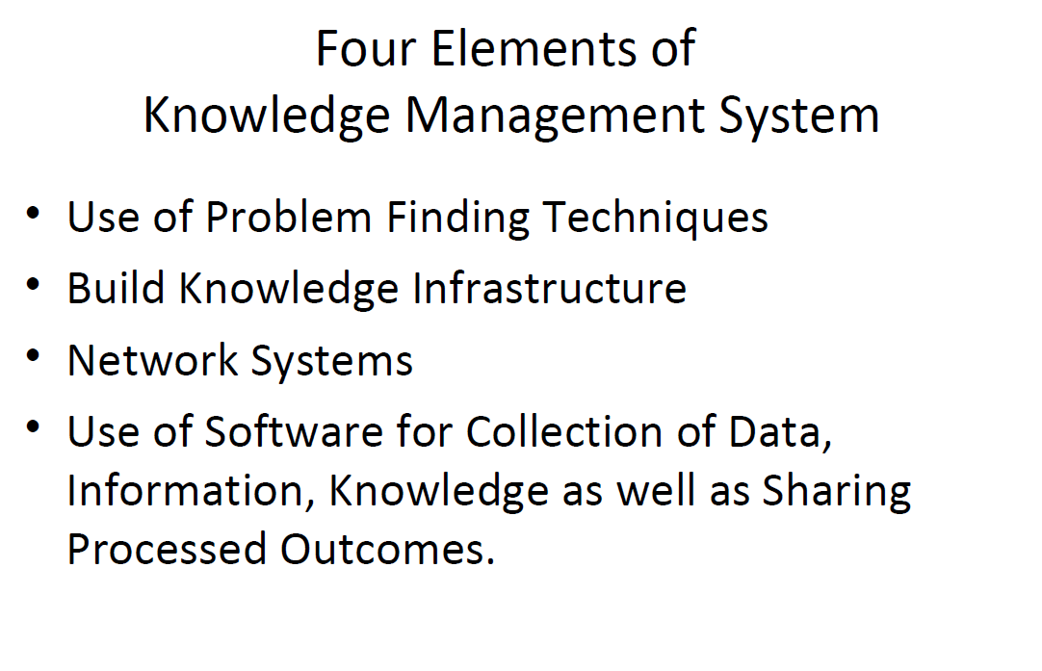

Slide 17
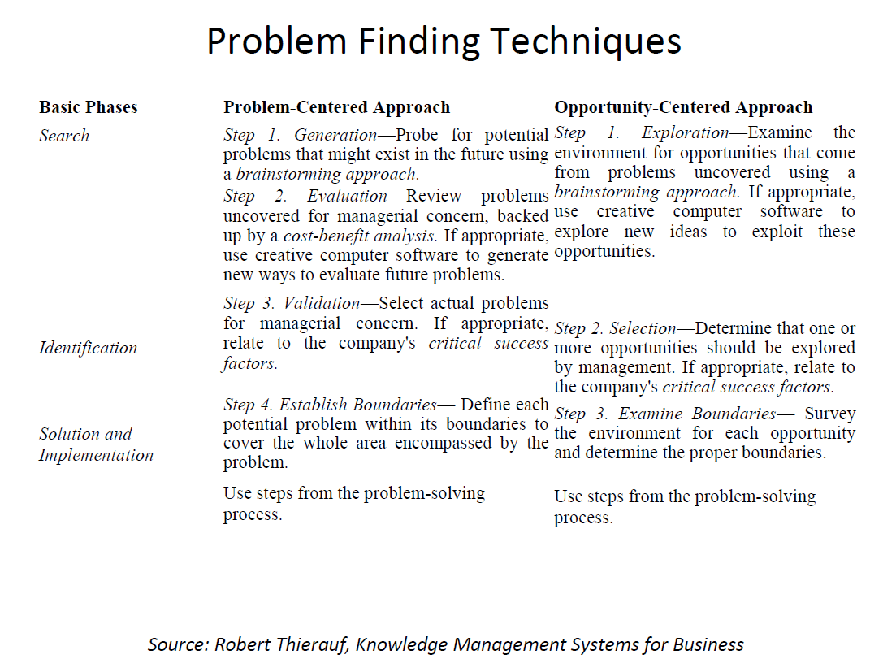

Slide 18
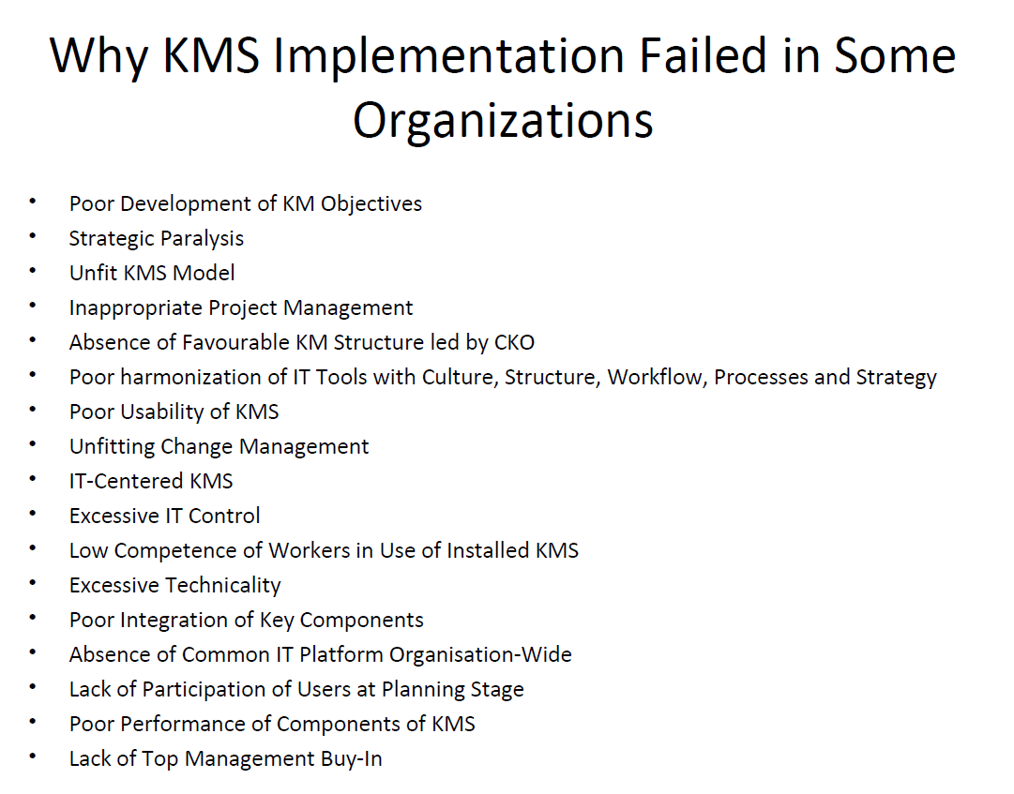

Slide 19
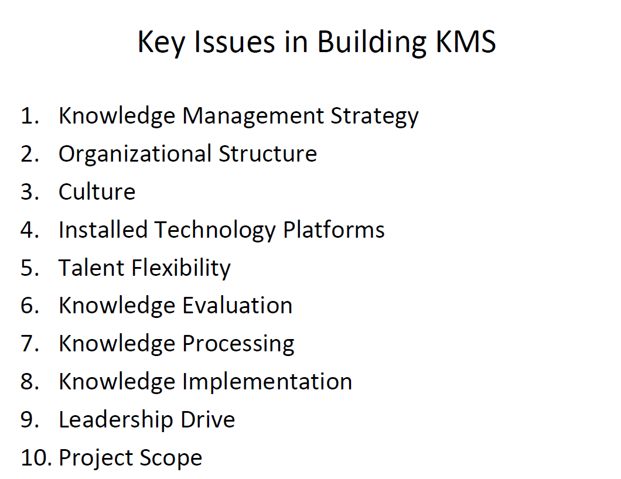

Slide 20
Challenges in KM Systems Development
Changing Organizational Culture:
Involves changing people's attitudes and behaviours.
Knowledge Evaluation:
Involves assessing the worth of information.
Knowledge Processing:
Involves the identification of techniques to acquire, store, process and distribute
information. Sometimes it is necessary to document how certain decisions were reached.
Knowledge Implementation:
An organization should commit to change, learn, and innovate.
It is important to extract meaning from information that may have an impact on specific missions.
Lessons learned from feedback can be stored for future to help others facing the similar
problem(s).

Slide 21
Conventional Vs KM Systems Life Cycle (KMSLC)
Key Differences
The systems analyst gathers data and information from the users and the users depend on analysts for the solution.
The knowledge developer gathers knowledge from people with known knowledge and the developer depends on them for the solution.
The main interface for the systems analyst is associated with novice users who knows the problem but not the solution.
The main interface for the knowledge developer is associated with the knowledgeable person who knows the problem and the solution.
Conventional systems development is primarily sequential, whereas KMSLC is incremental and interactive.

Slide 22
In case of conventional systems, testing is usually done towards the end of the cycle (after the system has been built), whereas in KMSLC, the evolving system is verified and validated from the beginning of the cycle.
Systems development and systems management is much more extensive for conventional information systems than it is for KMSLC.
The conventional systems life cycle is usually process-driven and documentation-oriented whereas KMSLC is result-oriented.
The conventional systems development does not support tools such as rapid prototyping since it follows a predefined sequence of steps KMSLC can use rapid prototyping incorporating changes on the spot

Slide 23
Key Similarities
Both cycles starts with a problem and end with a solution.
The early phase in case of conventional systems development life cycle starts with information gathering.
In KMSLC the early phase needs knowledge capture.
Verification and validation of a KM system is often very similar to conventional systems testing.
Both the systems analyst and the knowledge developer needs to choose the appropriate tools for designing their intended systems.

Slide 24
KMSLC Approaches
Primarily due to lack of standardization, a number of approaches have been proposed for KMSLC.
The conventional systems development approach can still be used for developing KM systems, but it is usually being replaced by iterative design, prototyping etc.
Evaluating the Existing Infrastructure
KM systems are developed in order to satisfy the need for improving productivity and potential of employees and the company as a whole.
The existing knowledge infrastructure is evaluated so that it can give the perception that the present ways of doing things are not just abandoned in preference for a new system.

Slide 25
System Justification:
It involves answers to the following questions:
Is existing knowledge going to be lost through retirement, , transfer, or departure to other organizations?
Is the proposed KM system needed in multiple locations?
Are experts available and willing to support the building of the proposed KM system?
Does the concerned problem needs years of proper experience and cognitive reasoning to solve?
While undergoing knowledge capture, would it be possible for the expert to articulate how the problem will be solved?
How critical is the knowledge that is to be captured?
Are the involved tasks nonalgorithmic in nature?
Would it possible to find a champion within the organization?

Slide 26
Scoping: the term scoping means limiting the breadth and depth of the project within the financial,
human resource, and operational constraints

Slide 27
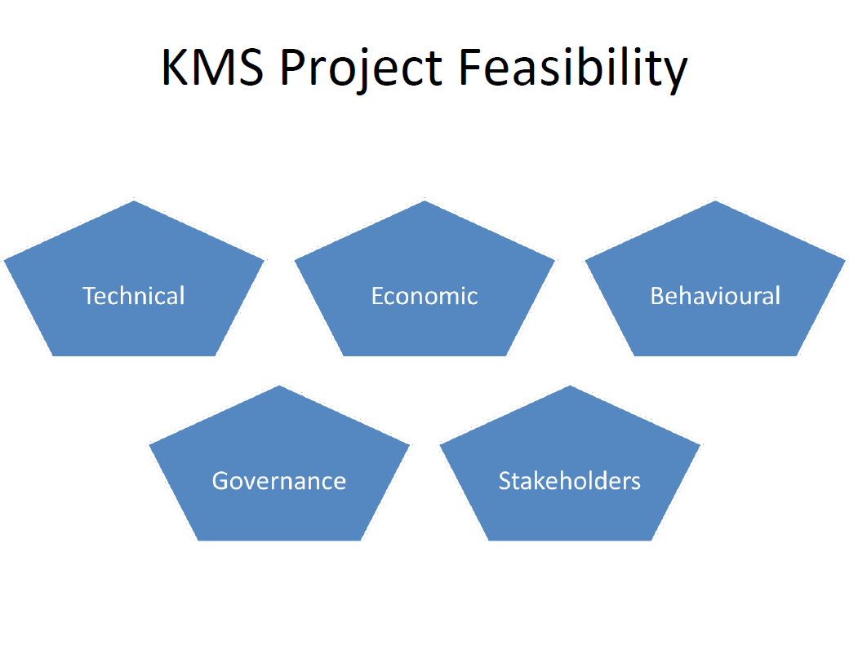

Slide 28
Feasibility:
Feasibility study involves addressing the following questions:
Is it possible to complete the project within the expected timeframe?
Is the project affordable?
Is the project appropriate?
How frequently the system would be consulted at what will be associated cost?
The traditional approach used to conduct a feasibility study can be used for building a KM system
Notes:
This involves the following Forming a knowledge management team.
Preparing a master plan.
Performing cost/benefit analysis of the proposed system.
Quantifying system criteria and costs.

Slide 29
User Support
Is the proposed user aware of the fact that the new KM system is being developed? How it is perceived?
How much involvement can be expected from the user while the building process continues?
What type of users training will needed when the proposed system is up and running?
What kind of operational support should be provided?

Slide 30
Role of Strategic Planning
lAs a consequence of evaluating the existing infrastructure, the concerned organization should develop a strategic plan which should aim at advancing the objectives of the organization with the proposed KM system in mind.
lAreas to be considered:
Vision
Resources
Culture

Slide 31
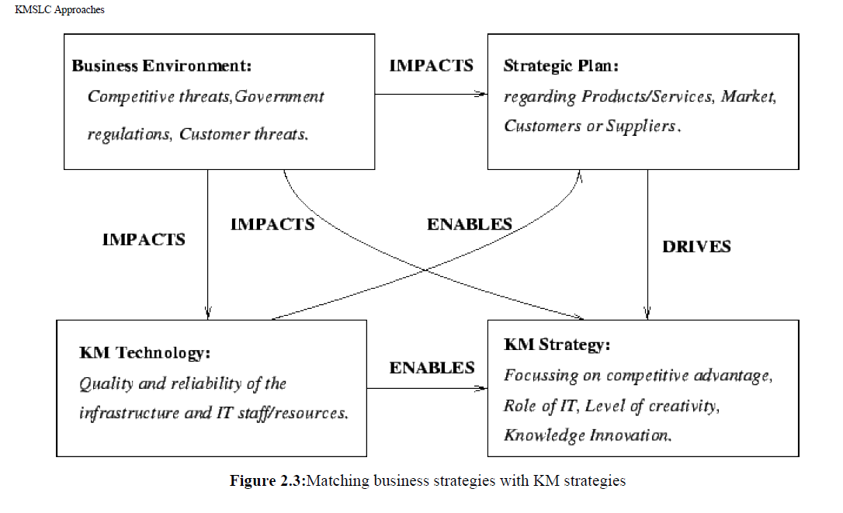

Slide 32
Forming a KM team
Forming a KM team usually means:
Identifying the key units, branches, divisions etc. as the key stakeholders in the prospective KM system.
Strategically, technically, and organizationally balancing the team size and competency.
Factors impacting team success:
Quality and capability of team members (in terms of personality, experience, and communication skill).
Size of the team.
Complexity of the project.
Team motivation and leadership
Promising only what that can be actually delivered.

Slide 33
Capturing Knowledge
Capturing Knowledge involves extracting, analyzing and interpreting the concerned knowledge that a human expert uses to solve a specific problem.
Explicit knowledge is usually captured in repositories from appropriate documentation, files etc.
Tacit knowledge is usually captured from experts, and from organization's stored database(s).
Interviewing is one of the most popular methods used to capture knowledge.
Data mining is also useful in terms of using intelligent agents that may analyze the data warehouse and come up with new findings.
In KM systems development, the knowledge developer acquires the necessary heuristic knowledge from the experts for building the appropriate knowledge base.
Knowledge capture and knowledge transfer are often carried out through teams
Knowledge capture includes determining feasibility, choosing the appropriate expert, tapping the experts knowledge, retapping knowledge to plug the gaps in the system, and verify/validate the knowledge base
Notes:
Data Mining, the practice of analysing large databases in order to generate new information.
It is also known as knowledge discovery in data (KDD), the process of finding anomalies, patterns and correlations within large data sets to predict outcomes (create new knowledge).

Slide 34
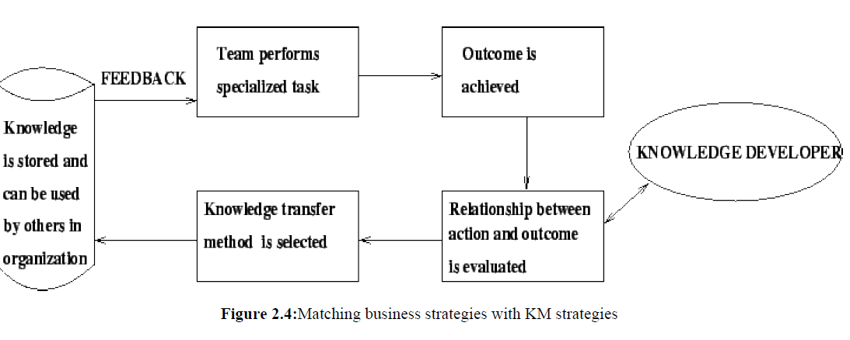

Slide 35
Rapid Prototyping:
Knowledge developers use iterative approach for capturing knowledge.
Foe example, the knowledge developer may start with a prototype (based on the somehow limited knowledge captured from the expert during the first few sessions).
The following can turn the approach into rapid prototyping:
Knowledge developer explains the preliminary/fundamental procedure based on rudimentary knowledge extracted from the expert during the few past sessions.
The expert reacts by saying certain remarks.
While the expert watches, the knowledge developer enters the additional knowledge into the computer-based system (that represents the prototype).
The knowledge developer again runs the modified prototype and continues adding additional knowledge as
suggested by the expert till the expert is satisfied.
The spontaneous, and iterative process of building a knowledge base is referred to as rapid prototyping.
Notes:
Iterative design is a special approach based on a cyclic process of prototyping, testing, analyzing, and refining the product.

Slide 36
Expert Selection
Some common questions that may arise in case of expert selection:
How to know that the so-called expert is in fact an expert?
Will he/she stay with the project till its completion?
What backup would be available in case the expert loses interest or quits?
How is the knowledge developer going to know what does and what does not lie within the expert's area of expertise?

Slide 37
The Role of the Knowledge Developer
The knowledge developer can be considered as the architect of the system.
He/she identifies the problem domain, captures knowledge, writes/tests the heuristics that represent knowledge, and coordinates the entire project.
Some necessary attributes of knowledge developer:
Communication skills.
Knowledge of knowledge capture tools/technology.
Ability to work in a team with professional/experts.
Tolerance for ambiguity.
To be able ti think conceptually.
Ability to frequently interact with the champion, knowledge workers and knowers in the organization.

Slide 38
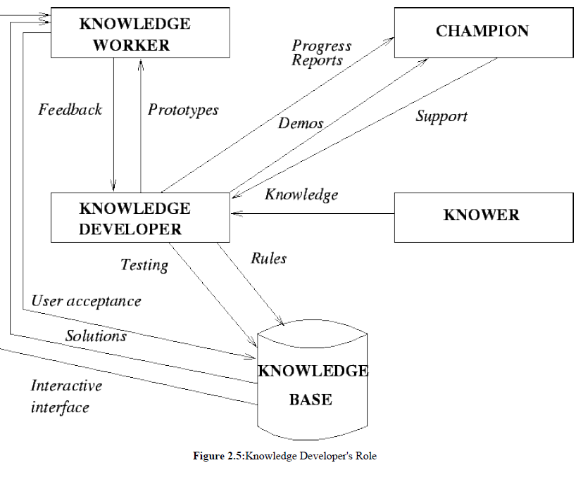
Notes:
a store of information or data that is available to draw on.
A good Knowledge Champion is someone who can enforce behaviors yet remain collegial, and knows when to take the lead and when to relinquish control.
Knower:

Slide 39
Designing the KM Blueprint
This phase indicates the beginning of designing the IT infrastructure/ Knowledge Management infrastructure. The KM Blueprint
(KM system design) addresses a number of issues.
Aiming for system interoperability/scalability with existing IT infrastructure of the organization.
Finalizing the scope of the proposed KM system.
Deciding about the necessary system components.
Developing the key layers of the KM architecture to meet organization's requirements. These layers are:
User interface
Authentication/security layer
Collaborative agents and filtering
Application layer
Transport internet layer
Physical layer
Repositories

Slide 40
Testing the KM System
This phase involves the following two steps:
Verification Procedure: Ensures that the system is right, i.e., the programs do the task that they are designed to do.
Validation Procedure: Ensures that the system is the right system - it meets the user's expectations, and will be usable on demand.
Implementing the KM System
After capturing the appropriate knowledge, encoding in the knowledge base, verifying and validating; the next task of the
knowledge developer is to implement the proposed system on a server.
Implementation means converting the new KM system into actual operation.
Conversion is a major step in case of implementation.
Some other steps are postimplementation review and system maintenance.

Slide 41
Quality Assurance
It indicates the development of controls to ensure a quality KM system. The types of errors to look for:
Reasoning errors
Ambiguity
Incompleteness
False representation
Training Users
The level/duration of training depends on the user's knowledge level and the system's attributes.
Users can range from novices (casual users with very limited knowledge) to experts (users with prior IT experience and knowledge of latest technology).
Users can also be classified as tutors (who acquires a working knowledge in order to keep the system current), pupils (unskilled worker who tries to gain some understanding of the captured knowledge), or customers (who is interested to know how to use the KM system).
Training should be geared to the specific user based on capabilities, experience and system complexity.
Training can be supported by user manuals, explanatory facilities, and job aids.

Slide 42
Managing Change
Implementation means change, and organizational members usually resist change. The resistors may include:
Experts
Regular employees (users)
Troublemakers
Narrow minded people
Resistance can be seen in the form of following personal reactions:
Projection, i.e., hostility towards peers.
Avoidance, i.e., withdrawal from the scene.
Aggression.

Slide 43
Knowledge Creation & Knowledge Architecture

